Slide 1
Acids & Bases

Slide 2
Revision: Reactions of acids & bases
Acid + Metal Hydroxide → Salt + Water
Acid + Metal Oxide → Salt + Water
Acid + Carbonate → Salt + Water + CO₂
Acid + Hydrogen carbonate → Salt + Water + CO₂
Acid + Reactive metal → Salt + Hydrogen gas
Base + Ammonium salt → Salt + Water + Ammonia gas

Slide 3
Arrhenius theory
Main principles:
Acids produce H⁺ ions when dissolved in water
Bases produce OH⁻ ions when dissolved in water
Acids and bases neutralise each other: H⁺(aq) + OH⁻(aq) → H₂O(ℓ)
Ionisation / Dissociation equations
Ionisation refers to a covalent molecular substance forming ions
HCℓ(aq) → H⁺(aq) + Cℓ⁻(aq)
CH₃COOH(aq) ⇌ CH₃COO⁻(aq) + H⁺(aq)
Dissociation refers to the separation of ions from an ionic substance when dissolved in water
NaOH(s) → Na⁺(aq) + OH⁻(aq)
Ba(OH)₂(s) → Ba²⁺(aq) + 2 OH⁻(aq)

Slide 4
Arrhenius theory
Monoprotic acids:
Only contain one ionisable proton Examples: HCℓ, HNO₃, CH₃COOH
Polyprotic acids:
Contain multiple ionisable protons Diprotic: H₂SO₄, H₂CO₃ Triprotic: H₃PO₄
Each ionisation step can be shown separately… (successive ionisation)
H₃PO₄(aq) ⇌ H⁺(aq) + H₂PO₄⁻(aq)
H₂PO₄⁻(aq) ⇌ H⁺(aq) + HPO₄²⁻(aq)
HPO₄²⁻(aq) ⇌ H⁺(aq) + PO₄³⁻(aq)
…or summarised into a single equation
H₃PO₄(aq) ⇌ 3 H⁺(aq) + PO₄³⁻(aq)

Slide 5
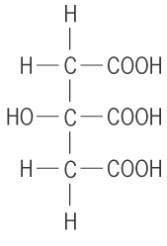
Arrhenius theory
Citric acid (C₆H₈O₇) is a weak, triprotic acid. Write a successive ionisation equations for citric acid.
C₆H₈O₇(aq) ⇌ C₆H₇O₇⁻(aq) + H⁺(aq)
C₆H₇O₇⁻(aq) ⇌ C₆H₆O₇²⁻(aq) + H⁺(aq)
C₆H₆O₇²⁻(aq) ⇌ C₆H₅O₇³⁻(aq) + H⁺(aq)

Slide 6
Monoprotic & Polyprotic acids
Determining whether acids are monoprotic or polyprotic:
Affects how many moles of acid are needed to neutralise a base.
Equation Moles NaOH Moles acid needed
NaOH + HCℓ → NaCℓ + H₂O 1.00 mol 1.00 mol
2 NaOH + H₂SO₄ → Na₂SO₄ + 2 H₂O 1.00 mol 0.50 mol
3 NaOH + H₃PO₄ → Na₃PO₄ + 3 H₂O 1.00 mol 0.33 mol
How could you experimentally determine whether an acid is monoprotic, diprotic or triprotic? What equipment and chemicals would you need?

Slide 7
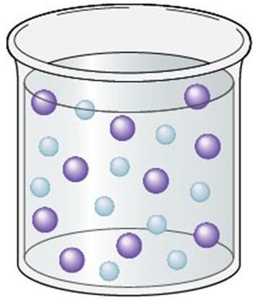
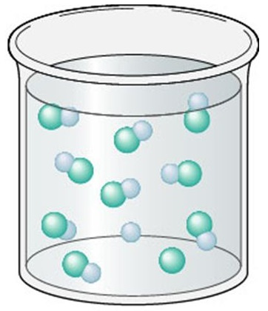
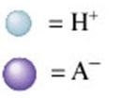


Strong vs Weak
Strong acids fully ionise in solution.
Weak acids only partially ionise in solution. They exist in equilibrium with molecules.
Example:
HA is a strong acid… HB is a weak acid… HA(aq) → H⁺(aq) + A⁻(aq) HB(aq) ⇌ H⁺(aq) + B⁻(aq)

Slide 8
Strong vs Weak
Common acids:
Strong acids |  | Weak acids
Hydrochloric acid | HCℓ | Ethanoic acid | CH₃COOH
Nitric acid | HNO₃ | Carbonic acid | H₂CO₃
Sulfuric acid * | H₂SO₄ | Phosphoric acid | H₃PO₄
 |  | Hydrofluoric acid | HF
 |  | Sulfurous acid | H₂SO₃
* Note: Only the first ionisation of sulfuric acid is strong. The second ionisation is weak.
H₂SO₄(aq) → H⁺(aq) + HSO₄⁻(aq)
HSO₄⁻(aq) ⇌ H⁺(aq) + SO₄²⁻(aq)

Slide 9
Strong vs Weak
Common bases:
Strong bases |  | Weak bases
Metal hydroxides. e.g. | NaOH | Ammonia | NH₃
 | KOH | Methylamine | CH₃NH₂
 | Ba(OH)₂ | Carbonate ion | CO₃²⁻

Slide 10
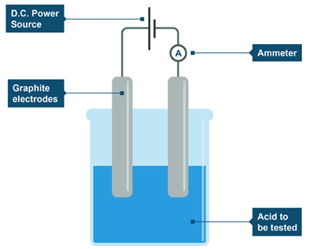
Evidence of Arrhenius Theory
Conductivity:
Solutions can be classified as:
Strong electrolytes (conduct electricity well)
Weak electrolytes (conduct electricity poorly)
Non-electrolytes (do not conduct electricity)
Conduction of electricity is related to presence of mobile charged particles (e.g. individual ions)
All solutions of acids and bases conduct electricity, ∴ all solutions of acids and bases contain free ions

Slide 11
Evidence of Arrhenius Theory
Electrical conductivity as KOH is added to 5 mol of HNO₃ solution
For the graph to the left:
With the aid of an equation, explain why the solution of HNO₃ conducts electricity
With the aid of an equation, explain why electrical conductivity decreases as KOH is added
Explain why the electrical conductivity reaches a minimum after 5 moles of KOH is added, then increases again
Electrical conductivity
0
5
10
Moles of KOH added

Slide 12
Evidence of Arrhenius Theory
Electrical conductivity as Ba(OH)₂ is added to 5 mol of H₂SO₄ solution
For the graph to the left:
Using equations, explain the shape of the graph.
Electrical conductivity
0
5
10
Moles of Ba(OH)₂ added

Slide 13
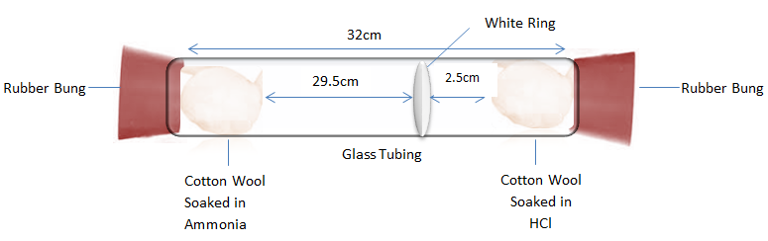
Problems with Arrhenius theory
*
Some substances such as ammonia (NH₃) and sodium carbonate (Na₂CO₃) were known to be basic, but didn’t contain OH in their formula.
Some scientists argued that Arrhenius theory was still valid, because these substances could react with water to form OH⁻ ions.
NH₃(aq) + H₂O(ℓ) ⇌ NH₄⁺(aq) + OH⁻(aq)
CO₃²⁻(aq) + H₂O(ℓ) ⇌ HCO₃⁻(aq) + OH⁻(aq)
However, pure gaseous ammonia reacts with HCℓ even when there is no water present.
NH₃(g) + HCℓ(g) → NH₄Cℓ(s)

Slide 14
Problems with Arrhenius theory
*
According to Arrhenius theory, acids and bases should produce neutral solutions, because the H⁺ ions will react with the OH⁻ ions to produce water.
e.g. HCℓ(aq) + NaOH(aq) → NaCℓ(aq) + H₂O(ℓ) NaCℓ(aq) is neutral ✓
However some acid-base reactions produce basic solutions
e.g. CH₃COOH(aq) + NaOH(aq) → NaCH₃COO(aq) + H₂O(ℓ) NaCH₃COO(aq) is basic, not neutral
And some acid-base reactions produce acidic solutions
e.g. HCℓ(aq) + NH₃(aq) → NH₄Cℓ(aq) NH₄Cℓ(aq) is acidic, not neutral

Slide 15
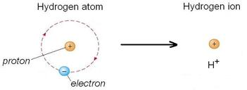
Problems with Arrhenius theory
*
H⁺ represents an individual proton.
In reality, H⁺(aq) would be too unstable to exist in solution for significant amounts of time. It would quickly react with water to form hydronium ion (H₃O⁺).
H⁺(aq) + H₂O(ℓ) → H₃O⁺(aq)

Slide 16
Brønsted-Lowry Theory
Definitions:
Acids are substances that donate one or more protons (‘proton donors’)
Bases are substances that accept one or more protons (‘proton acceptors’)
H
–
+
N
H
Cℓ
+
H
H

Slide 17
Brønsted-Lowry Theory
Definitions:
Acids are substances that donate one or more protons (‘proton donors’)
Bases are substances that accept one or more protons (‘proton acceptors’)
H
+
H
–
N
H
N
H
Cℓ
+
Cℓ
+
H
H
H
H
HCℓ donates a proton
∴ HCℓ acts as an acid
NH₃ accepts a proton
∴ NH₃ acts as a base

Slide 18
Brønsted-Lowry Theory
Definitions:
Acids are substances that donate one or more protons (‘proton donors’)
Bases are substances that accept one or more protons (‘proton acceptors’)
H
–
–
Cℓ
+
O
H

Slide 19
Brønsted-Lowry Theory
Definitions:
Acids are substances that donate one or more protons (‘proton donors’)
Bases are substances that accept one or more protons (‘proton acceptors’)
H
–
–
H
+
O
+
O
Cℓ
Cℓ
H
H
HCℓ donates a proton
∴ HCℓ acts as an acid
OH⁻ accepts a proton
∴ OH⁻ acts as a base

Slide 20
Brønsted-Lowry Theory
Acids and bases in aqueous solutions:
Brønsted-Lowry theory also applies to acids and bases dissolving in water to form an aqueous solution. Water will either accept to proton to form H₃O⁺(aq) or donate a proton to form OH⁻(aq).
H
–
+
Cℓ
+
O
H
H

Slide 21
Brønsted-Lowry Theory
Acids and bases in aqueous solutions:
Brønsted-Lowry theory also applies to acids and bases dissolving in water to form an aqueous solution. Water will either accept to proton to form H₃O⁺(aq) or donate a proton to form OH⁻(aq).
H
–
H
+
+
O
+
O
Cℓ
Cℓ
H
H
H
H
HCℓ donates a proton
∴ HCℓ acts as an acid
H₂O accepts a proton
∴ H₂O acts as a base

Slide 22
Brønsted-Lowry Theory
Acids and bases in aqueous solutions:
Brønsted-Lowry theory also applies to acids and bases dissolving in water to form an aqueous solution. Water will either accept to proton to form H₃O⁺(aq) or donate a proton to form OH⁻(aq).
+
H
-
H
+
O
N
H
H
H

Slide 23
Brønsted-Lowry Theory
Acids and bases in aqueous solutions:
Brønsted-Lowry theory also applies to acids and bases dissolving in water to form an aqueous solution. Water will either accept to proton to form H₃O⁺(aq) or donate a proton to form OH⁻(aq).
+
H
H
–
N
H
+
N
H
+
O
O
H
H
H
H
H
H
NH₃ accepts a proton
∴ NH₃ acts as a base
H₂O donates a proton
∴ H₂O acts as an acid

Slide 24
Brønsted-Lowry Theory
HCℓ(aq) + H₂O(ℓ) → H₃O⁺(aq) + Cℓ⁻(aq) NH₃(aq) + H₂O(ℓ) → NH₄⁺(aq) + OH⁻(aq)
Substances which can either accept or donate protons such as water are called amphiprotic or amphoteric.
Base
(Proton acceptor)
Acid
(Proton donor)

Slide 25
Brønsted-Lowry Theory
IMPORTANT! This affects how we write ionisation equations for acids.
Arrhenius theory: HCℓ(g) → H⁺(aq) + Cℓ⁻(aq)
Brønsted-Lowry theory: HCℓ(g) + H₂O(ℓ) → H₃O⁺(aq) + Cℓ⁻(aq)

Slide 26
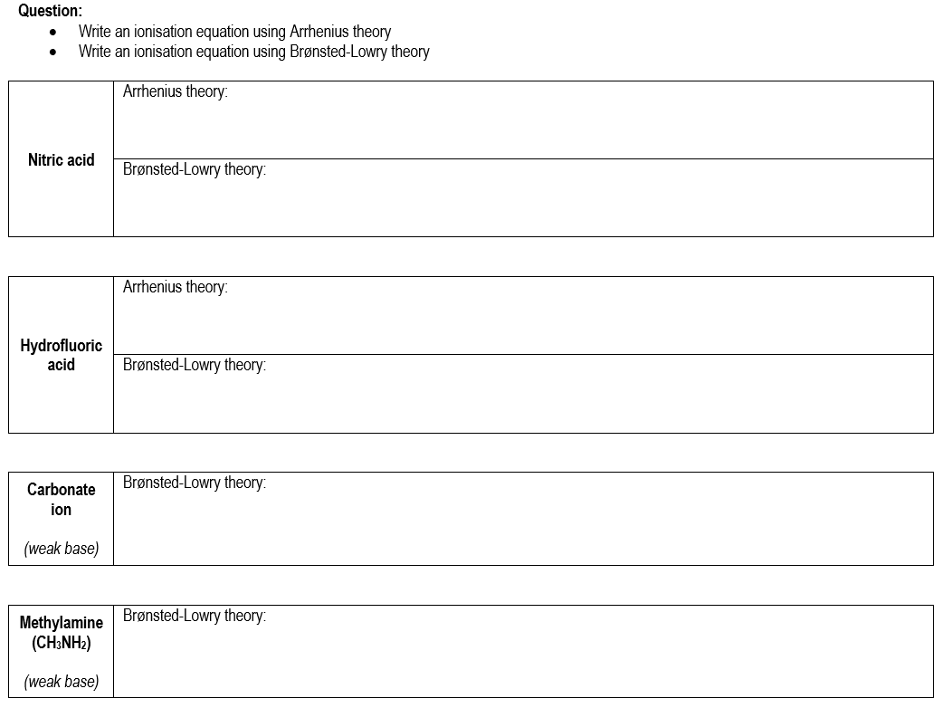

Slide 27
Brønsted-Lowry Theory
Identify the Brønsted-Lowry acids and bases. Show reasoning.
HSO₄⁻(aq) + HCO₃⁻(aq) → SO₄²⁻(aq) + H₂CO₃(aq)
C₆H₅O⁻(aq) + NH₃(aq) → C₆H₅OH(aq) + NH₂⁻(aq)

Slide 28
Conjugate acids and bases
Recall that ammonia is a weak base, hence its ionisation is a reversible reaction.
How would you classify:
Ammonia (NH₃)
Water (H₂O)
Ammonium (NH₄⁺)
Hydroxide (OH⁻)
-
H +
H
+
O
N
H
H
H

Slide 29
Conjugate acids and bases
Recall that ammonia is a weak base, hence its ionisation is a reversible reaction.
+
H
H
–
N
H
+
N
H
+
O
O
H
H
H
H
H
H
Base
(Accepts proton)
Acid
(Donates proton)
Acid
(Donates proton)
Base
(Accepts proton)

Slide 30
Conjugate acids and bases
Reaction between acetic acid and sodium carbonate:
How would you classify:
Ethanoic acid (CH₃COOH)
Carbonate ion (CO₃²⁻)
Ethanoate ion (CH₃COO⁻)
Hydrogencarbonate (HCO₃⁻)
2 –
–
H
H
O
+
O
C
C
H
C
O
H
O
O

Slide 31
Conjugate acids and bases
Reaction between acetic acid and sodium carbonate:
2–
H
–
–
H
H
O
H
O
+
O
C
C
H
+
O
C
C
H
C
C
O
O
O
H
O
O
O
H
Base
(Accepts proton)
Acid
(Donates proton)
Acid
(Donates proton)
Base
(Accepts proton)

Slide 32
Conjugate acids and bases
In a reversible reaction:
The species produced from a weak acid will be basic
The species produced from a weak base will be acidic
These groups are referred to as conjugate acid-base pairs
Conjugate pair #2
Base
Acid
HNO₂(aq) + H₂O(ℓ) ⇌ NO₂⁻(aq) + H₃O⁺(aq)
Acid
Base
Conjugate pair #2

Slide 33
Conjugate acids and bases
Conjugate pair #2
Base
Acid
HNO₂(aq) + H₂O(ℓ) ⇌ NO₂⁻(aq) + H₃O⁺(aq)
Acid
Base
Conjugate pair #2
For the above equation it can also be said that:
NO₂⁻ is the conjugate base of HNO₂ H₂O is the conjugate base of H₃O⁺
HNO₂ is the conjugate acid of NO₂⁻ H₃O⁺ is the conjugate acid of H₂O
An acid and its conjugate base will only differ in formula by one H⁺ ion.

Slide 34
Brønsted-Lowry Review Questions

Slide 35
Chemical equilibrium
Consider a solution of ethanoic acid in equilibrium:
CH₃COOH(aq) + H₂O(ℓ) ⇌ CH₃COO⁻(aq) + H₃O⁺(aq)
This solution would be in chemical equilibrium, therefore we can apply principles from the equilibrium topic.
While in equilibrium, the rate of forward and reverse reactions would be equal
While in equilibrium, the concentration of all species would remain constant
Changing the concentration of a species would affect equilibrium.
e.g. according to Le Châtelier’s Principle, removing H₃O⁺ would cause reaction to shift to the right

Slide 36

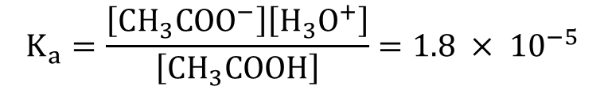
Chemical equilibrium
As with other systems, we can write equilibrium constant expressions to show the relative concentrations of species at equilibrium.
For the ionisation of an acid, this value is called the acid dissociation constant (K_{a}).
CH₃COOH(aq) + H₂O(ℓ) ⇌ CH₃COO⁻(aq) + H₃O⁺(aq)
HF(aq) + H₂O(ℓ) ⇌ F⁻(aq) + H₃O⁺(aq)
$$K_{a}=\frac{\left[{CH}_{3}{COO}^{−}\right]\left[H_{3}O^{+}\right]}{\left[{CH}_{3}COOH\right]}=1.8 × {10}^{−5}$$
Complete the expression →
$$K_{a}=\frac{ }{ }=7.2 × {10}^{−4}$$

Slide 37
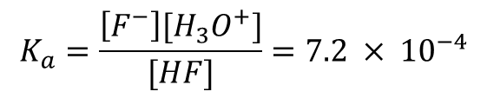
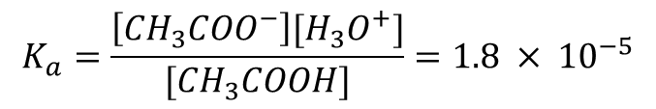
Equilibrium constants
$$K_{a}=\frac{\left[{{CH}_{3}COO}^{−}\right][{H_{3}O}^{+}]}{[{CH}_{3}COOH]}=1.8 × {10}^{−5}$$
CH₃COOH(aq) + H₂O(ℓ) ⇌ CH₃COO⁻(aq) + H₃O⁺(aq)
HF(aq) + H₂O(ℓ) ⇌ F⁻(aq) + H₃O⁺(aq)
Q: What does the size of the acid dissociation constant (K_{a}) for CH₃COOH indicate?
Q: What do the K_{a} vales of CH₃COOH and HF indicate about their relative strengths?
$$K_{a}=\frac{\left[F^{−}\right][{H_{3}O}^{+}]}{[HF]}=7.2 × {10}^{−4}$$

Slide 38
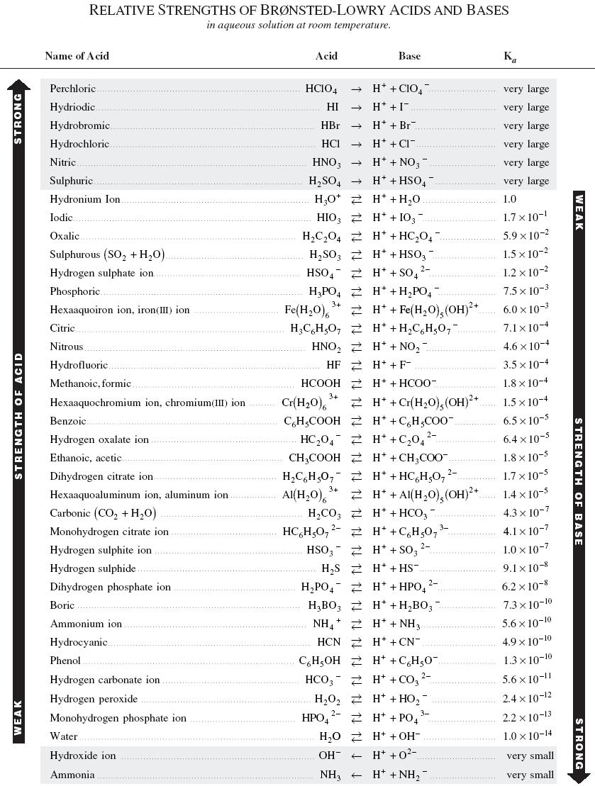

Slide 39
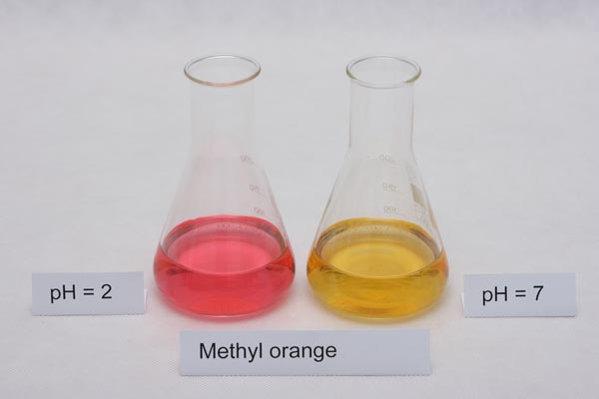
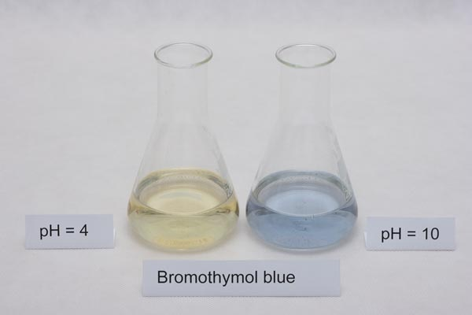
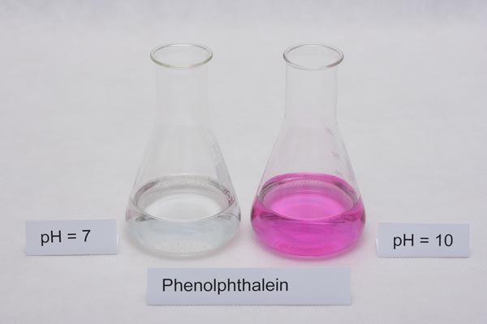
Indicators
Indicators are chemical species that change colour in different pH conditions. Most indicators are an acid-base conjugate pair, where each species in the pair is a different colour.

Slide 40
Indicators
General equation: HIn(aq) + H₂O(ℓ) ⇌ In⁻(aq) + H₃O⁺(aq)
colour 1 colour 2
In the above equation, “In” is used as shorthand for “indicator”. The indicator molecule can either be protonated (HIn) or de-protonated (In⁻).
Assume that there is initially an equal mix of HIn(aq) and In⁻(aq).
According the Le Châtelier’s principle, what would happen to the colour if…
HCℓ(aq) was added?
NaOH(aq) was added?

Slide 41
Indicators
Phenolphthalein: H-phph(aq) + H₂O(ℓ) ⇌ phph⁻(aq) + H₃O⁺(aq)
colourless bright pink/purple
Explain using Le Châtelier’s principle why phenolphthalein turns purple in solutions with pH >9.

Slide 42


Indicators
Methyl orange indicator:
+ H₃O⁺(aq) ⇌
+ H₂O(ℓ)
(Meor⁻)
(H-Meor)
Determine the colours of Meor⁻ and H-Meor. Justify your decision using Le Châtelier’s principle.

Slide 43
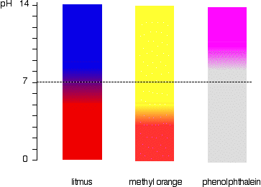
Indicators
Most indicators only have 2 or 3 different coloured forms. Indicators do not necessarily change at pH 7. Their changing point depends on the equilibrium constant for that indicator. Universal indicator is made of a mixture of four different types of indicator. This allows it to display a wide range of colours across the pH scale.

Slide 44
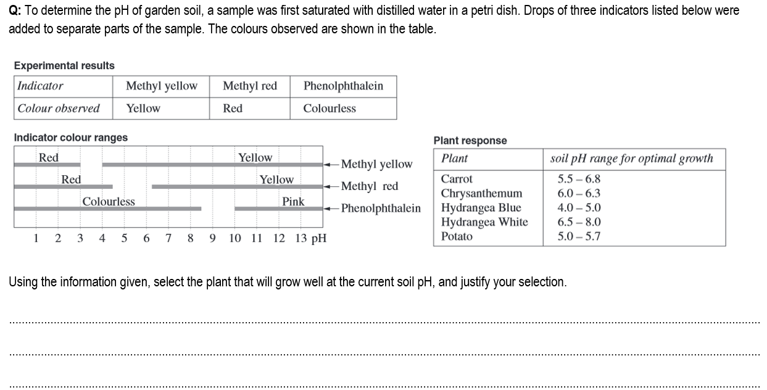

Slide 45
Salts from acid-base reactions
Salts are ionic compounds produced after the reaction of an acid and a base.
In general, the cation of the salt comes from the base and the anion comes from the acid.
Not all salts are neutral. Salts may be acidic or basic!
KOH(aq) + HNO₃(aq) → KNO₃(aq) + H₂O(ℓ)
salt

Slide 46
Neutral salts
Salts produced from a strong acid and a strong base are neutral.
Example: Sodium chloride is a neutral salt produced from HCℓ and NaOH
HCℓ(aq) + NaOH(aq) → NaCℓ(aq) + H₂O(ℓ)
When solid sodium chloride is dissolved in water it dissociates, but does not react with water to produce H₃O⁺ or OH⁻ ions.
NaCℓ(s) → Na⁺(aq) + Cℓ⁻(aq)

Slide 47
Basic salts
If is salt is produced from a weak acid, then the resulting salt will be basic.
Example: Sodium acetate is produced from the reaction between CH₃COOH and NaOH
CH₃COOH(aq) + NaOH(aq) → NaCH₃COO(aq) + H₂O(ℓ)
When solid sodium acetate is dissolved in water it first dissociates, but then the acetate ion will react with water to produce OH⁻ ions.
CH₃COO⁻(aq) + H₂O(ℓ) ⇌ CH₃COOH(aq) + OH⁻(aq)
This occurs because CH₃COO⁻ is the conjugate base of CH₃COOH.
^ makes the solution basic!

Slide 48
Acidic salts
If is salt is produced from a weak base, then the resulting salt will be acidic.
Example: Ammonium chloride is produced from the reaction between HCℓ and NH₃
HCℓ(aq) + NH₃(aq) → NH₄Cℓ(aq)
When solid ammonium chloride is dissolved in water it first dissociates, but then the ammonium ion will react with water to produce H₃O⁺ ions.
NH₄⁺(aq) + H₂O(ℓ) ⇌ NH₃(aq) + H₃O⁺(aq)
This occurs because NH₄⁺ is the conjugate acid of NH₃.
^ makes the solution acidic!

Slide 49
Salts from polyprotic acids
If is salt is produced from a polyprotic acid, then the resulting salt might be acidic or basic, depending on which acid is involved.
Consider the salt sodium hydrogencarbonate (NaHCO₃). When dissolved in water, it will first dissociate and then the HCO₃⁻ can react with water. But it can do so in two different ways…
HCO₃⁻(aq) + H₂O(ℓ) ⇌ CO₃²⁻(aq) + H₃O⁺(aq) If HCO₃⁻ loses a proton then the resulting solution is acidic
or
HCO₃⁻(aq) + H₂O(ℓ) ⇌ H₂CO₃(aq) + OH⁻(aq) If HCO₃⁻ gains a proton then the resulting solution is basic

Slide 50
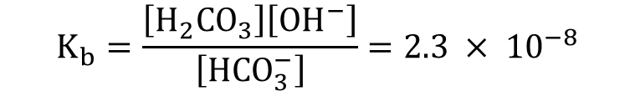
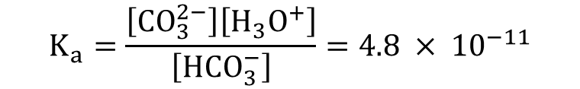
Salts from polyprotic acids
HCO₃⁻(aq) + H₂O(ℓ) ⇌ CO₃²⁻(aq) + H₃O⁺(aq) If HCO₃⁻ loses a proton then the resulting solution is acidic
or
HCO₃⁻(aq) + H₂O(ℓ) ⇌ H₂CO₃(aq) + OH⁻(aq) If HCO₃⁻ gains a proton then the resulting solution is basic
The final pH of the solution depends on which of the above reactions occurs to the greatest extent. This could be compared using equilibrium constants.
Based on the K_{a} and K_{b} values, would the HCO₃⁻ form an acidic or basic solution? Explain.
$$K_{a}=\frac{\left[{CO}_{3}^{2−}\right]\left[H_{3}O^{+}\right]}{\left[{HCO}_{3}^{−}\right]}=4.8 × {10}^{−11}$$
$$K_{b}=\frac{\left[H_{2}{CO}_{3}\right]\left[{OH}^{−}\right]}{\left[{HCO}_{3}^{−}\right]}=2.3 × {10}^{−8}$$

Slide 51
Salts from polyprotic acids
Unless provided with K_{a} and K_{b} values in a test, there is no way to determine whether an ion like HCO₃⁻ would form an acidic or basic solution.
That means that you will have to memorise the following table so you can correctly remember which salts from polyprotic acids are acidic, basic and neutral.
Related acid | Acidic ions (will donate proton and form H₃O⁺) | Basic ions (will accept proton and form OH⁻)
Sulfuric acid | HSO₄⁻ | SO₄²⁻
Carbonic acid |  | HCO₃⁻ CO₃²⁻
Phosphoric acid | H₂PO₄⁻ | HPO₄²⁻ PO₄³⁻
Salts from the first ionisation of sulfuric and phosphoric are acidic
If you can’t remember in a test, guess basic

Slide 52
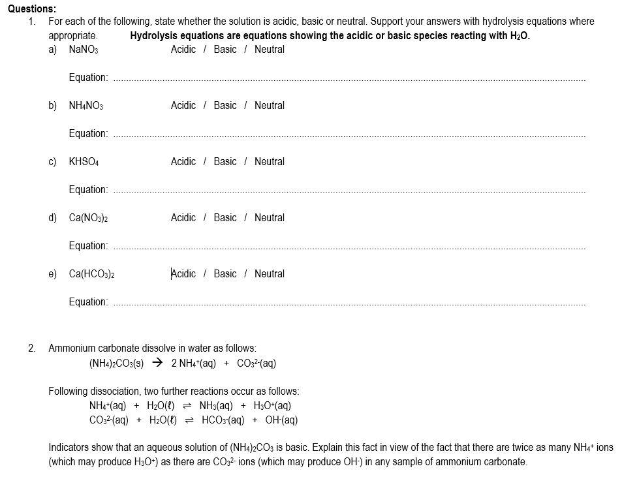

Slide 53
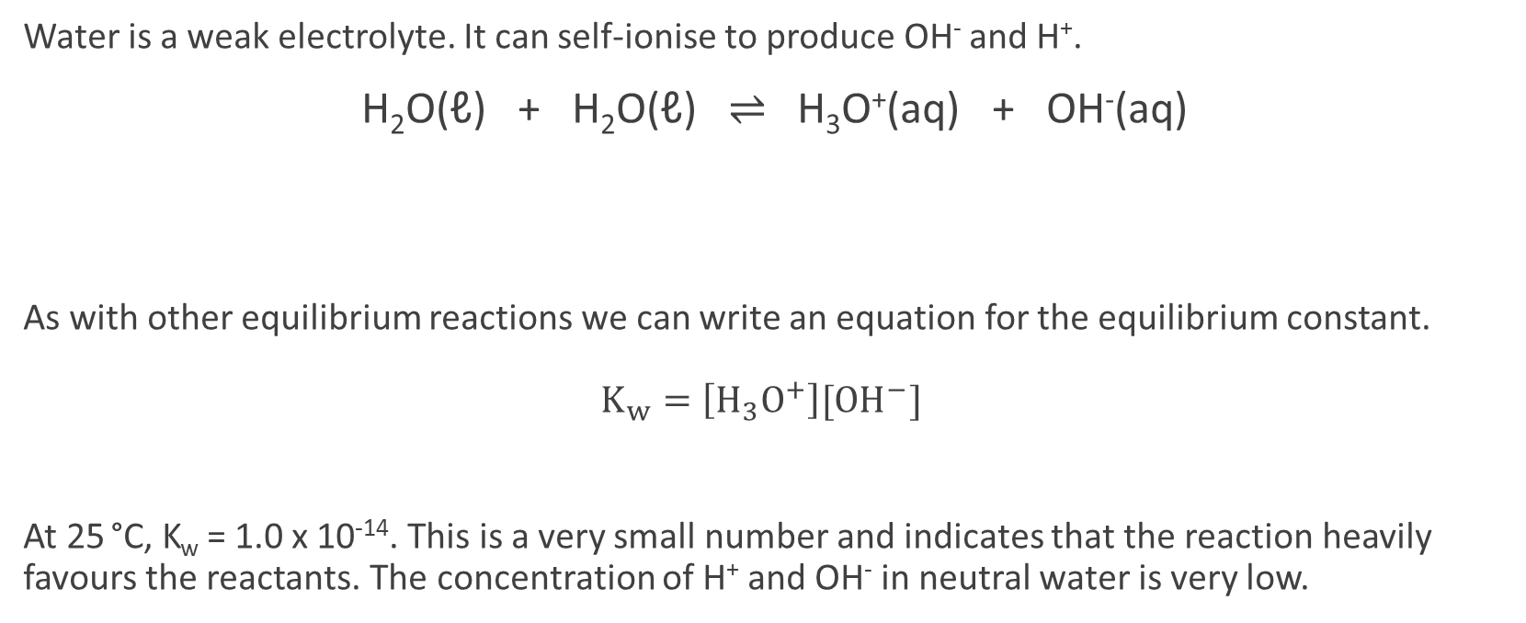
Water as an electrolyte
Water is a weak electrolyte. It can self-ionise to produce OH⁻ and H⁺.
H₂O(ℓ) + H₂O(ℓ) ⇌ H₃O⁺(aq) + OH⁻(aq)
As with other equilibrium reactions we can write an equation for the equilibrium constant. $K_{w}=\left[H_{3}O^{+}\right][{OH}^{−}]$
At 25 °C, K_{w} = 1.0 x 10⁻¹⁴. This is a very small number and indicates that the reaction heavily favours the reactants. The concentration of H⁺ and OH⁻ in neutral water is very low.
Base
Gains a proton
Acid
Loses a proton

Slide 54


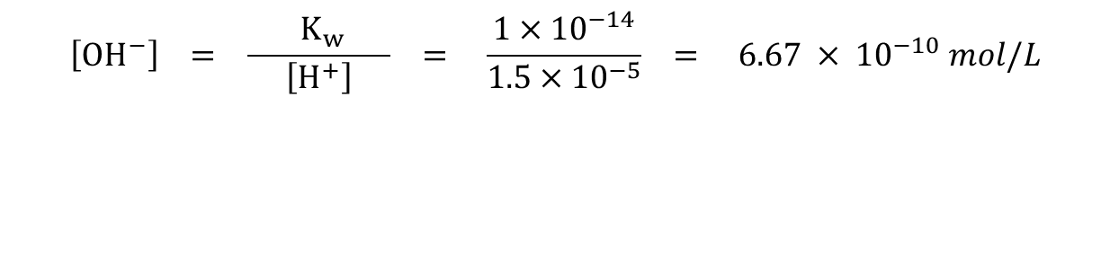
Calculating [H⁺] and [OH⁻]
Note: In these calculations, H⁺ and H₃O⁺ can be used interchangeably. H⁺ (from Arrhenius theory) is usually shown in calculations because it is faster and easier than writing H₃O⁺.
If we know [H⁺] in a solution, then we can calculate [OH⁻] using the value of K_{w}.
e.g. A solution of acid contains 1.5 x 10⁻⁵ mol L⁻¹ of H⁺. Calculate [OH⁻].
$${ K}_{w}=\left[H^{+}\right]\left[{OH}^{−}\right] \\ ∴\left[{OH}^{−}\right]=\frac{{ K}_{w} }{\left[H^{+}\right]}=\frac{1×{10}^{−14}}{\left[H^{+}\right]}$$
$$\left[{OH}^{−}\right] = \frac{{ K}_{w} }{\left[H^{+}\right]} = \frac{1×{10}^{−14}}{1.5×{10}^{−5}} = 6.67 × {10}^{−10} mol/L$$

Slide 55
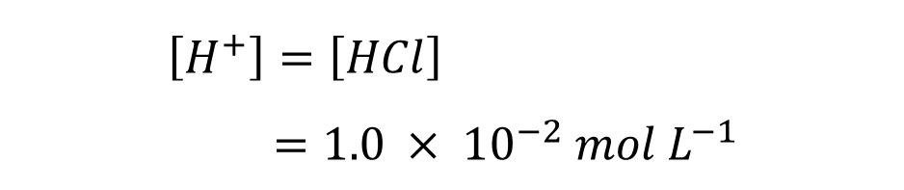

Calculating [H⁺] and [OH⁻]
Example: Calculate the concentration of H⁺ and OH⁻ in a 1.0 x 10⁻² mol L⁻¹ HCℓ solution at 25 °C.
HCℓ(g) → H⁺(aq) + Cℓ⁻(aq)
$${ K}_{w}=\left[H^{+}\right]\left[{OH}^{−}\right] \\ \left[{OH}^{−}\right]=\frac{K_{w}}{\left[H^{+}\right]} \\ =\frac{1.0 × {10}^{−14}}{1.0 × {10}^{−2}} \\ =1.0 × {10}^{−12} mol L^{−1}$$
$$\left[H^{+}\right]=\left[HCl\right] \\ =1.0 × {10}^{−2} mol L^{−1}$$

Slide 56

Calculating [H⁺] and [OH⁻]
Note that we can also rearrange the K_{w} equation to find [H⁺] if we know [OH⁻].
Complete questions on opposite page of workbook.
$${ K}_{w}=\left[H^{+}\right]\left[{OH}^{−}\right] \\ ∴\left[H^{+}\right]=\frac{{ K}_{w} }{\left[{OH}^{−}\right]}=\frac{1×{10}^{−14}}{\left[{OH}^{−}\right]}$$

Slide 57
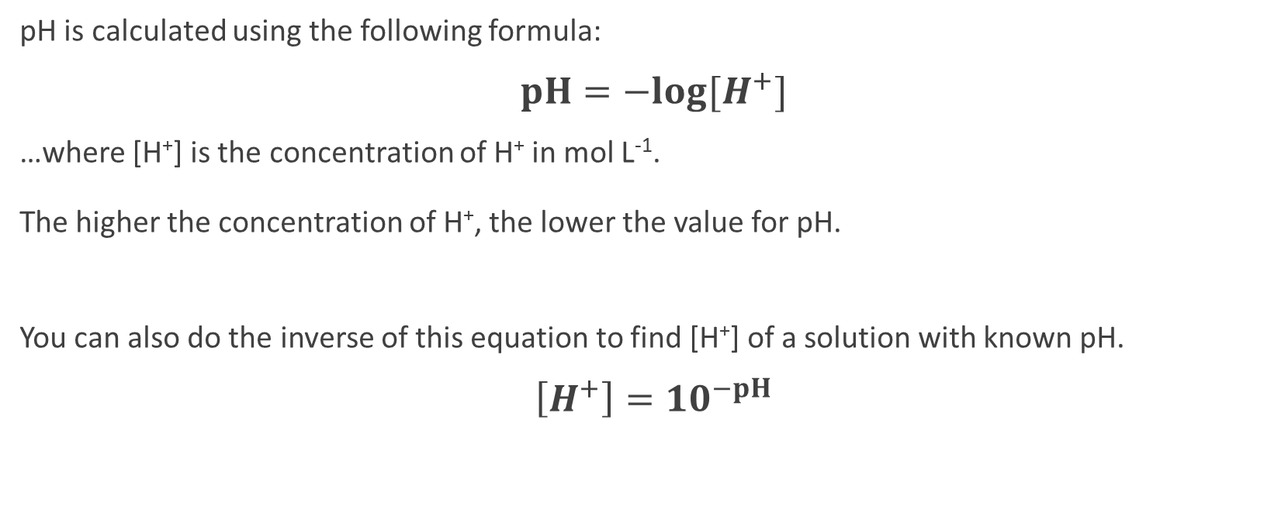
pH scale
pH is calculated using the following formula:
$pH=−log⁡[H^{+}]$
…where [H⁺] is the concentration of H⁺ in mol L⁻¹. The higher the concentration of H⁺, the lower the value for pH.
You can also do the inverse of this equation to find [H⁺] of a solution with known pH.
$\left[H^{+}\right]={10}^{−pH}$

Slide 58

Calculating pH – Strong acids
To calculate the pH of a strong acid solution…
1. Find [H⁺]
2. Perform the pH calculation
e.g. Calculate the pH of a 0.06 mol L⁻¹ solution of HCℓ.
$\left[H^{+}\right]=\left[HCl\right]=0.06 mol L^{−1}$
$pH=−\log\left[H^{+}\right]$ $=−\log\left[0.06\right]$ $=1.22$

Slide 59
Calculating pH – Strong acids
Q: Calculate the pH of a 5.0 x 10⁻³ mol L⁻¹ solution of HNO₃
Q: 2 litres of hydrogen chloride gas (HCℓ) is collected at S.T.P. and is dissolved in 500 L of water. Calculate the pH of the resulting solution.

Slide 60
Calculating pH – Strong bases
There are two ways to go about this. Both methods rely on the fact that [OH⁻] and [H⁺] are linked. Remember, K_{w} = [H⁺][OH⁻]
Method 1 (longer):
1. Find [OH⁻]
2. Find [H⁺] using the relationship with K_{w}. [H⁺] = K_{w} / [OH⁻]
3. Find pH using the formula pH = -log[H⁺]

Slide 61


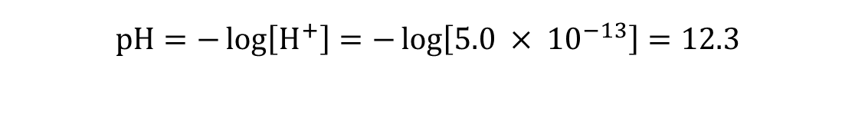
Calculating pH – Strong bases
Example (Method 1): Calculate the pH of a 2.0 x 10⁻² mol L⁻¹ NaOH solution.
NaOH → Na⁺ + OH⁻
$$\left[H^{+}\right]=\frac{K_{w}}{\left[{OH}^{−}\right]} \\ =\frac{1.0 × {10}^{−14}}{2.0 × {10}^{−2}} \\ =5.0 × {10}^{−13} mol L^{−1}$$
2
$$\left[{OH}^{−}\right]=\left[NaOH\right] \\ =2.0 × {10}^{−2} mol L^{−1}$$
1
3
$$pH=−\log\left[H^{+}\right]=−\log\left[5.0 × {10}^{−13}\right]=12.3$$

Slide 62
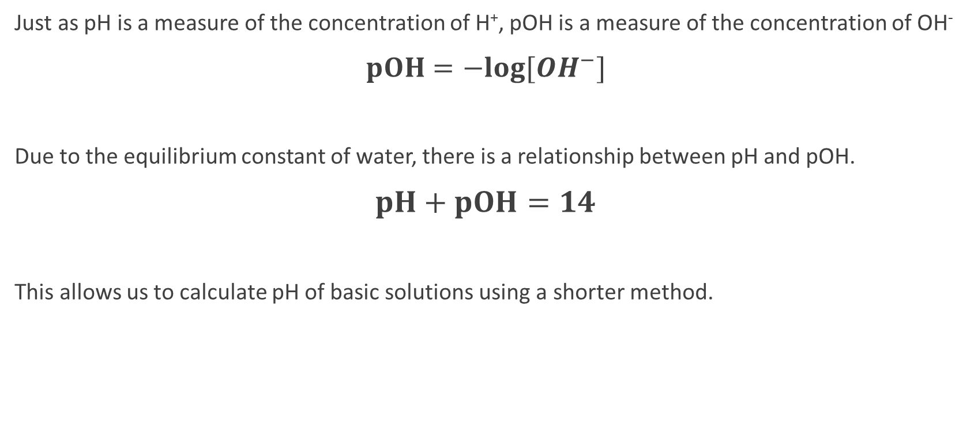
Calculating pH – Strong bases
Just as pH is a measure of the concentration of H⁺, pOH is a measure of the concentration of OH⁻
$pOH=−log⁡[{OH}^{−}]$
Due to the equilibrium constant of water, there is a relationship between pH and pOH.
$pH+pOH=14$
This allows us to calculate pH of basic solutions using a shorter method.

Slide 63
Calculating pH – Strong bases
Method 2 (shorter):
1. Find [OH⁻]
2. Find pOH using the formula pOH = -log[OH⁻]
3. Find pH using the formula pH = 14 – pOH

Slide 64
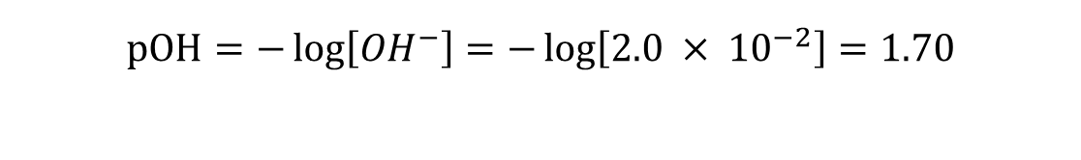

Calculating pH – Strong bases
Example (Method 2): Calculate the pH of a 2.0 x 10⁻² mol L⁻¹ NaOH solution.
NaOH → Na⁺ + OH⁻
$$\left[{OH}^{−}\right]=\left[NaOH\right] \\ =2.0 × {10}^{−2} mol L^{−1}$$
1
2
$$pOH=−\log\left[{OH}^{−}\right]=−\log\left[2.0 × {10}^{−2}\right]=1.70$$
$$pH=14 −pOH=14 −1.70=12.3$$
3

Slide 65
Calculating pH – Mixing two acids
Some problems might involve two acidic solutions with different pH values being mixed together.
To solve:
1. Find n(H⁺) in the first solution n(H⁺)₁
2. Find n(H⁺) in the second solution n(H⁺)₂
3. Find the total n(H⁺) ions n(H⁺)_{total} = n(H⁺)₁ + n(H⁺)₂
4. Find the concentration of the total n(H⁺). Remember to use the volume of the total solution
5. Calculate pH as per previous pages

Slide 66
Calculating pH – Mixing two acids
Example: 100 mL of 0.005 mol L⁻¹ HCℓ is added to 200 mL of 0.0001 mol L⁻¹ HCℓ
Total volume = 300 mL = 0.3 L
c(H⁺)_{total} = n / V
= 0.0007 / 0.300
= 0.002333 mol L⁻¹
1
n(H⁺)₁ = c x V
= 0.005 x 0.100
= 0.0005 mol
4
2
n(H⁺)₂ = c x V
= 0.0001 x 0.200
= 0.0002 mol
pH = -log[H⁺]
= -log[0.002333]
= 2.63
5
3
n(H⁺)_{total} = n(H⁺)₁ + n(H⁺)₂
= 0.0005 + 0.0002
= 0.0007 mol

Slide 67
Calculating pH – Mixing two bases
Perform this calculation in the same way as mixing two acids, only now you will be finding n(OH⁻).
To solve:
1. Find n(OH⁻) in the first solution n(OH⁻)₁
2. Find n(OH⁻) in the second solution n(OH⁻)₂
3. Find the total n(OH⁻) ions n(OH⁻)_{total} = n(OH⁻)₁ + n(OH⁻)₂
4. Find the concentration of the total n(OH⁻). Remember to use the volume of the total solution
5. Calculate pH as per previous pages

Slide 68
Calculating pH – Mixing acid + base
Sometimes you may have a question where a strong acid is mixed with a strong base. Acids and bases neutralise each other…
H⁺ + OH⁻ → H₂O
…but if excess acid is used then the resulting solution will be acidic, and if excess base is used then the resulting solution will be basic.
You may need to calculate the pH of such a solution after the acid and base have been mixed together.

Slide 69
Calculating pH – Mixing acid + base
Method:
1. Find n(H⁺)
2. Find n(OH⁻)
3. Figure out which substance is in excess. Calculate n(H⁺ excess) or n(OH⁻ excess)
4. Find the concentration of the excess ions. Remember to use the volume of the total solution
5. Calculate pH as per previous pages

Slide 70
Calculating pH – Mixing acid + base
Example: 100 mL of 1 mol L⁻¹ Ca(OH)₂ is added to 400 mL of 0.300 mol L⁻¹ HCℓ. What is the pH of the new solution?
pOH = -log[OH⁻]
= -log[0.16]
= 0.796
pH = 14 – pOH
= 13.2
1
n(Ca(OH)₂) = c x V
= 1 x 0.1
= 0.1 mol
n(OH⁻) = 2 x n(Ca(OH)₂)
= 0.2 mol
3
H⁺ + OH⁻ → H₂O
n(OH⁻ excess) = n(OH⁻) - n(H⁺)
= 0.200 – 0.120
= 0.080 mol
5
Total volume = 500 mL = 0.5 L
c(OH⁻ excess) = n / V
= 0.080 / 0.500
= 0.16 mol L⁻¹
4
n(HCℓ) = c x V
= 0.300 x 0.400
= 0.120 mol
n(H⁺) = 0.120 mol
2

Slide 71
Acidic, Basic & Neutral
A neutral solution is defined as a solution with equal concentrations of H⁺ and OH⁻.
Even though pure water self-ionises to produce small amounts of [H⁺] and [OH⁻], the resulting solution will still be neutral because [H⁺] = [OH⁻]
H₂O ⇌ H⁺ + OH⁻
Acidic
Neutral
Basic
[H⁺] > [OH⁻]
[H⁺] = [OH⁻]
[H⁺] < [OH⁻]

Slide 72
pH of Neutral Solutions
We can calculate the pH of neutral water at 25 °C by combining two equations:
Equation 1: [H⁺] = [OH⁻] This equation is true for any neutral solution
Equation 2: K_{w} = [H⁺] [OH⁻] Equilibrium constant for water.
1 x 10⁻¹⁴ = [H⁺] [OH⁻] This is the value of K_{w} at 25 °C

Slide 73

pH of Neutral Solutions
Example: Show using calculations that the pH of neutral water at 25 ºC is equal to 7.
$$K_{w}=\left[H^{+}\right]\left[{OH}^{−}\right] The solution is neutral, ∴\left[H^{+}\right]= \left[{OH}^{−}\right] \\ ={\left[H^{+}\right]}^{2} At 25 ℃,K_{w}=1.0 ×{10}^{−14} \\ 1.0 ×{10}^{−14}={\left[H^{+}\right]}^{2} \\ \left[H^{+}\right]=\sqrt{1.0 ×{10}^{−14}} \\ =1 × {10}^{−7}$$
$$pH=−log\left[H^{+}\right]$$ $=−\log\left[1 × {10}^{−7}\right]$
$$=7.00$$

Slide 74
Effect of temperature of pH
Like all equilibrium reactions, the self-ionisation of water is affected by temperature.
Investigate the table to the right. Is the self-ionisation of water an exothermic or endothermic process? Explain your answer in terms of Le Châtelier’s principle.
Temperature (°C) | K_{w}
0 | 0.11 x 10⁻¹⁴
10 | 0.29 x 10⁻¹⁴
20 | 0.68 x 10⁻¹⁴
25 | 1.01 x 10⁻¹⁴
30 | 1.47 x 10⁻¹⁴
40 | 2.92 x 10⁻¹⁴
50 | 5.48 x 10⁻¹⁴
100 | 51.3 x 10⁻¹⁴

Slide 75
Effect of temperature of pH
You should be able to calculate the pH of neutral water at any temperature if given the value of K_{w}.
The working will be similar to that on the previous page
Q: Calculate the pH of water at the following temperatures. Use the K_{w} values from the table above.
Neutral water at 10 ºC
Neutral water at 50 ºC

Slide 76
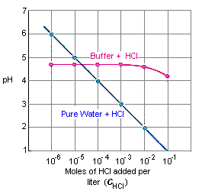
Buffers
A buffer is a solution that resists changes to pH. Graph to right…
Blue line: Solution without buffer
Addition of acid/base causes large pH changes
Pink line: Solution with buffer
pH remains constant while acid/base is added (until buffer ‘runs out’)

Slide 77
Buffers – Composition
Buffers are composed of a weak acid and its conjugate base.
Examples:
A mixture of acetic acid (CH₃COOH) and sodium acetate (NaCH₃COO)
A mixture of ammonia (NH₃) and ammonium chloride (NH₄Cl)
A mixture of phosphoric acid (H₃PO₄) and sodium phosphate (Na₃PO₄)

Slide 78
Buffering capacity
Buffering capacity is a measure of how well a buffer can resist changes to pH.
A buffer with a high buffering capacity can have a lot of acid and base added before pH changes
A buffer with a low buffering capacity can only prevent changes for a small amount of acid or base.
Two factors affect buffering capacity:
The relative amounts of the weak acid and its conjugate base. Buffers work best with equimolar amounts. e.g. 0.5 mol CH₃COOH + 0.5 mol CH₃COO⁻ _{c.f. 0.5 mol + 0.1 mol}
The overall concentration of the buffer High concentration of buffers are better. e.g. 2 mol CH₃COOH + 2 mol CH₃COO⁻ _{c.f. 0.5 mol + 0.5 mol}

Slide 79
How buffers work
Buffer solutions contain a weak acid and its conjugate base. These substances will be in equilibrium. Their ability to resist changes to pH can be understood using Le Châtelier’s Principle.
Q: Use Le Châtelier’s principle to explain why pH does not change when acid is added to a mixture of acetic acid and sodium acetate.
CH₃COOH + H₂O ⇌ CH₃COO⁻ + H₃O⁺
A:
When acid is added this would initially increase [H₃O⁺]
According to Le Châtelier’s Principle the system will react to oppose this change.
The reaction will shift to the left, decreasing [H₃O⁺] close to its original value
As [H₃O⁺] does not change greatly, there is little change to pH

Slide 80
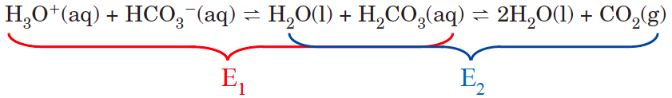
Applications of buffers
Blood:
Cells need to maintain a relatively constant pH in order for enzymes to function correctly.
The pH of blood maintains a pH between 7.35 and 7.45. This pH is maintained through a number of chemical buffers. One is an equilibrium system involving hydrogencarbonate ions, carbonic acid and CO₂(g).

Slide 81
Ocean Acidification
Increased atmospheric CO₂ levels: Nelson pg. 114
Combustion of fossil fuels leads to increased CO₂(g) emissions
Clearing of forests reduces amount of CO₂(g) consumed through photosynthesis
Enhanced greenhouse effect: Nelson pg. 115
Greenhouse gases in atmosphere (including CO₂) reduce the amount of heat energy escaping Earth. Instead this energy is radiated back towards the surface.
CO₂ dissolving into the ocean has had a positive effect on atmospheric warming. If no CO₂ dissolved into the oceans then atmospheric CO₂ levels would be higher, impacting on global temperatures.

Slide 82
Ocean Acidification
CO₂ equilibrium: Nelson pg. 113
Dissolved CO₂ undergoes a series of equilibrium reactions
CO₂(g) ⇌ CO₂(aq)
CO₂(aq) + H₂O(ℓ) ⇌ H₂CO₃(aq)
H₂CO₃(aq) + H₂O(ℓ) ⇌ H₃O⁺(aq) + HCO₃⁻(aq)
Le Châtelier’s principle predicts that increasing concentrations of CO₂(g) will increase [H₃O⁺] and [HCO₃⁻]

Slide 83
Ocean Acidification
Calcification: Nelson pg. 117
Many marine organisms build exoskeletons and shells from calcium carbonate.
Ca²⁺(aq) + CO₃²⁻(aq) ⇌ CaCO₃(s)
CaCO₃ has a very low solubility, which means it is able to exist as a saturated solution in the ocean.
Effect of ocean acidification: Nelson pg. 118
H⁺ ions can react with CO₃²⁻(aq): H⁺(aq) + CO₃²⁻(aq) ⇌ HCO₃⁻(aq)
Increased [H⁺] from ocean acidification…
…reduces [CO₃²⁻] in the ocean
…shifts the calcification equation to the left, decreasing ability of organisms to form CaCO₃ exoskeletons and shells
Effect on coral: Great Barrier Reef mass decreased 50% over last 27 years

Slide 84
Ocean Acidification
Actions to address CO₂ emissions: Nelson pg. 115
Intergovernmental Panel on Climate Change (IPCC)
Established 1988
Provides clear, scientific research on climate change to governmental bodies
Kyoto Protocol
1997 agreement between over 150 countries (including Australia) to set emission targets

Slide 85
Historical models
Boyle
Lavoisier
Davy
Arrhenius
Brønsted-Lowry
1660s
Boyle: Used litmus (a plant dye / indicator) to classify acids and bases.
Summarised following properties:
1770s
1810s
Acids | Bases (Alkalies)
Sour taste | Feel slippery
Corrosive
Turns blue litmus read | Turns red litmus blue
Becomes less acidic when combined with bases | Becomes less alkaline when combined with acids
1880s
1920s

Slide 86
Historical models
Boyle
Lavoisier
Davy
Arrhenius
Brønsted-Lowry
1660s
Lavoisier:
Studied the combustion of carbon, sulfur and phosphorus
When the non-metal oxides were dissolved in water, they were acidic
Carbonic acid Sulfuric acid Phosphoric acid
Defined acids as substances containing non-metal atoms and oxygen
1770s
1810s
1880s
1920s

Slide 87
Historical models
Boyle
Lavoisier
Davy
Arrhenius
Brønsted-Lowry
1660s
Davy:
Showed that ‘muriatic acid’ (hydrochloric acid) did not contain oxygen (opposing Lavoisier’s definition)
Defined acids as substances that contain hydrogen which would be replaced by metals
e.g. 2 HCℓ + Zn → ZnCℓ₂ + H₂
1770s
1810s
1880s
1920s

Slide 88
Historical models
Boyle
Lavoisier
Davy
Arrhenius
Brønsted-Lowry
1660s
Arrhenius:
Examined electrical conductivity of substances. Classified solutions that conduct electricity as “electrolytes”
Solutions of acids and bases conducted electricity, therefore were electrolytes
Proposed that acids dissolve to form H⁺ ions in solution
Proposed that bases dissolve to form OH⁻ ions in solution
e.g. HCℓ(aq) → H⁺(aq) + Cℓ⁻(aq)
NaOH(s) → Na⁺(aq) + OH⁻(aq)
Proposed that neutralisation was due to: H⁺(aq) + OH⁻(aq) → H₂O(ℓ)
1770s
1810s
1880s
1920s

Slide 89
Historical models
Boyle
Lavoisier
Davy
Arrhenius
Brønsted-Lowry
1660s
Problems with the Arrhenius model:
#1: Ammonia (NH₃) was known to be basic, but doesn’t contain OH ions
#2: Substances could act as acids or bases without dissolving in water first
#3: According to the Arrhenius model, all salts should be neutral because the H⁺ and OH⁻ have neutralised each other… But when HCℓ reacts with NH₃, the salt produced (NH₄Cℓ) is itself acidic.
#4: Individual protons (H⁺) do not exist for very long in water. They would quickly react with H₂O to form H₃O⁺ ions (hydronium ions).
1770s
1810s
1880s
1920s

Slide 90
Historical models
Boyle
Lavoisier
Davy
Arrhenius
Brønsted-Lowry
1660s
Brønsted-Lowry model:
Proposed that acids are proton donors
Proposed that bases are proton acceptors
Explained acidity of a greater range of substances. (See earlier parts of workbook for more details about Brønsted-Lowry model)
1770s
1810s
1880s
1920s

Slide 91
